Slide 1






Transfer War
Mixed Integer Linear Programming (MILP) with Buy/Sell Decisions + Competitive Denial (γ)
Real Madrid
FC Barcelona
Transfer Window Optimization
Students: Giannis Chrysomallis, Christos Asimakopoulos

Slide 2











Problem Definition
Two rival football clubs make optimal buy/sell decisions under budget constraints with and without competitive denial factor γ.
Competitive Hostility:
Denial Factor (γ): Enhances value of transfers that deprive opponents of critical players
Teams:
Real Madrid
γ
FC Barcelona
Real Madrid vs FC Barcelona
0 → 0.85
Constraints:
Strategic Dimensions:
Budget limitations
Squad structure requirements
Peace (γ=0)
War (γ>0)
Transfer window limitations
Pure team improvement
Asset denial + team improvement

Slide 3














Current State Analysis
Market Dataset
Squad Information
18,405 players
Attributes: name, club, position, estimated price, performance score (0-10)
Real Madrid
FC Barcelona
Player roles
Player ages
Estimated sell values
Market Modeling
Preselection Process
Market Friction: Player availability modeled probabilistically (p=0.85), same across scenarios
Top-N candidates per role based on score-to-cost ratio
Filter out current squad players
Apply club-blocking to prevent buying players from rivals
Real Madrid Budget: €500M
FC Barcelona Budget: €400M

Slide 4




















Model Overview
MILP Framework
Two Rival Teams
Buy/Sell Decisions
Strategic Value
Transfer Outcome
Peace Scenario (γ=0)
War Scenario (γ>0)
Decisions driven by internal team needs
Decisions incorporate competitive hostility
Focus on pure athletic performance
Asset denial becomes strategic objective
No strategic consideration for opponent
Transfer choices shift toward denial-relevant roles
Asset Denial Strategy
The denial factor (γ) enhances transfer value if it deprives an opponent of a critical player.
Strategic Value:
Combined Improvement:
This incorporates competitive hostility into the optimization model.
Internal + Denial:
Σt∈T (Σk∈S_t vt,k(1-yk,t) + Σi∈P (sint,r(i) + γsidt,r(i))xi,t)

Slide 5












Data Pipeline
Market Dataset
Filtering
Top-N Selection
Preprocessed Market
18,405 players
club-blocking + remove current-squad players
per role group
Reduced player pool
Club-blocking
Current-squad Removal
Top-N Selection
Prevents buying players from Real Madrid
Removes players already in target squad
Selects top-N candidates per role group
Prevents buying players from FC Barcelona
Freezes existing player positions
Prioritizes high scores and low costs
Prevents double-counting in optimization
Balances squad needs with budget constraints
Ensures team-specific player selection

Slide 6




















Sets, Parameters & Variables
Sets
Parameters
Decision Variables
Players (i): Individual players in the marketi ∈ P
Budgets (Bt): Financial resources
BReal = 500 (M€), BBarca = 400 (M€)
Buy Variables
Teams (t): Competing clubst ∈ T = {Real, Barca}
xi,t ∈ {0, 1}
Costs (ci): Acquisition cost for player i
1 if team t buys player i, 0 otherwise
Scores (si): Performance benefit scoresi ∈ [0, 10]
Role groups (g): Aggregated player positionsg ∈ G = {GK, CB, FB, MID, WING, ST}
Sell Variables
Need multipliers (nt,r(i)): Strategic importance of role
yk,t ∈ {0, 1}
Denial weights (dt,r(i)): Impact of denying role to opponent
1 if team t sells player k, 0 otherwise
Availability (ai): Binary market availabilityai ∈ {0,1} (p=0.85)

Slide 7










Objective Function
Maximize Total Strategic Value across both teams
maxt∈T ( Σk∈St vt,k(1−yk,t) + Σi∈P (si nt,r(i) + γ si dt,r(i)) xi,t )
Subject to: vt,k = sk nt,r(k)
Retained Players
New Acquisitions
Value of players kept from current squad:
Value of new players with denial factor γ:
Σk∈St vt,k(1−yk,t)
Σi∈P (si nt,r(i) + γ si dt,r(i)) xi,t
vt,k: Value of player k for team t
xi,t: 1 if player i is bought, 0 otherwise
yk,t: 1 if player k is sold, 0 otherwise
si: Performance score of player i
Denial Factor (γ)
γ = 0
γ > 0
γ = 0.5
Peace scenario
War scenario
Balanced approach

Slide 8








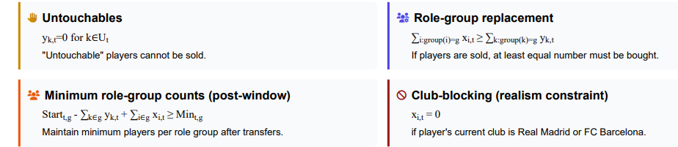




Constraints
Budget with sell revenue
Exclusivity
∑i ci xi,t ≤ Bt + ∑k SellValuek,t yk,t
∑t xi,t ≤ 1
Total cost must not exceed budget plus revenue.
Each player can be bought by at most one team.
Transfer cap
Linking
∑i xi,t ≤ Kt (Kt=4)
∑i xi,t = ∑k yk,t + Forcedt
Each team has max K=4 incoming transfers.
Incoming transfers must balance outgoing + forced departures.
Untouchables
Role-group replacement
yk,t=0 for k∈Ut
buys_in_group ≥ sells_in_group
"Untouchable" players cannot be sold.
If players are sold, at least equal number must be bought.
These constraints ensure the model remains realistic and feasible. The budget constraint incorporates sell revenue, while the linking constraint ensures transfer windows balance. Role-group constraints maintain squad structure. Club-blocking prevents buying current Real/Barca players.

Slide 9











Experiment Design
Fixed Seed Sensitivity
Robustness
Peace vs War
Analyzes model behavior across different levels of competitive hostility
Assesses stability of results across various market draws
Ensures differences are attributable to γ parameter only
Parameters:
Parameters:
Design:
seed=12345
10 replications (different seeds)
Same availability draw within run
γ={0, 0.25, 0.5, 0.75}
γ=0 vs γ=0.5
Compares γ=0 and γ>0
Ensures market availability constant
Compares "Peace" and "War" scenarios
Experimental Approach:
Systematic evaluation of model performance across different scenarios to validate conclusions

Slide 10
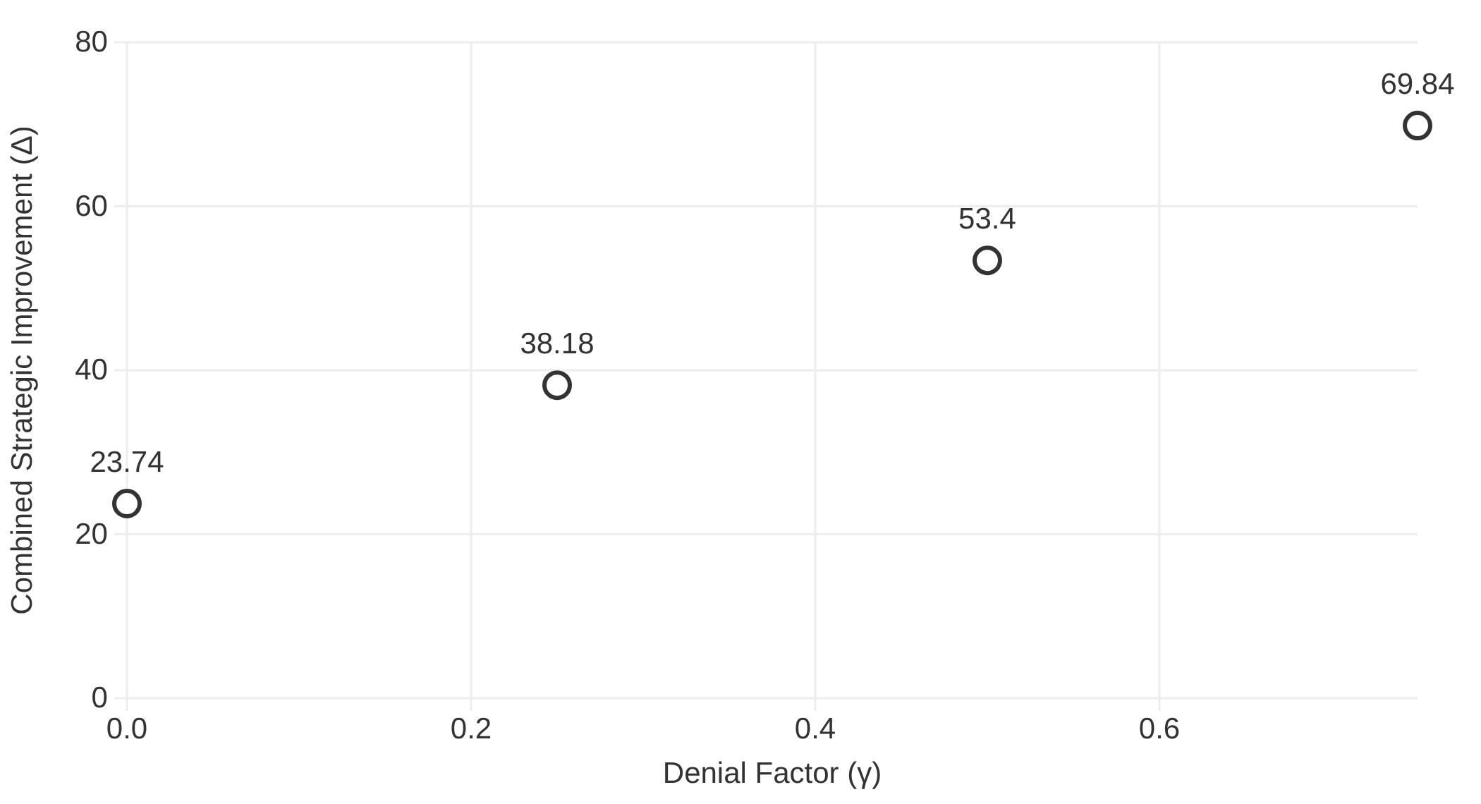


Combined Strategic Improvement
Key Insight
Combined strategic improvement increases with γ because denial is rewarded in the objective function.
Impact
Monotonic increase in performance
Strategic value grows with hostility
Takeaway:
As competitive hostility increases (γ), combined team value improves monotonically.

Slide 11
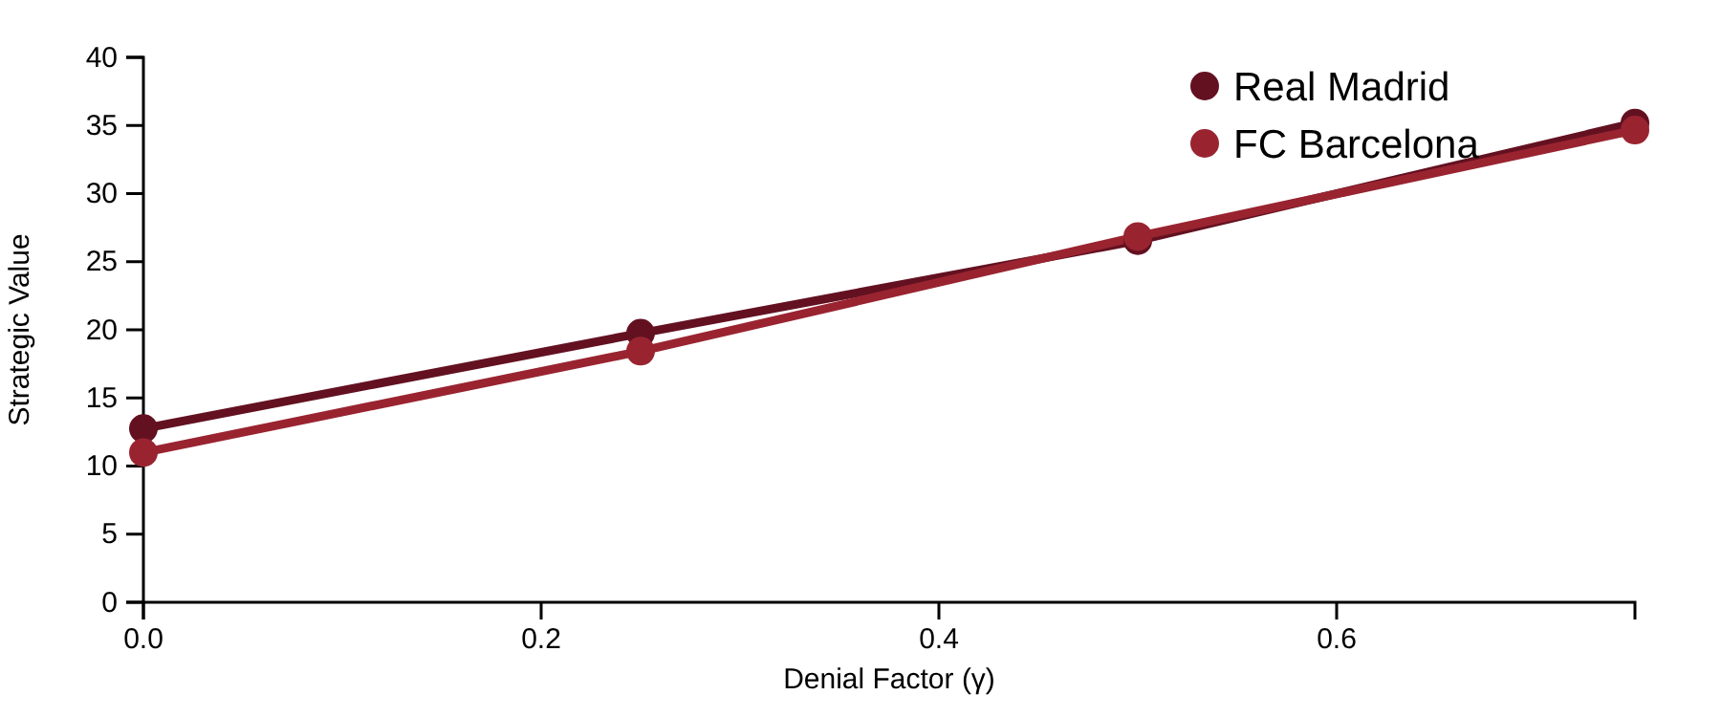


Team Strategic Values
Key Insights
Strategic Value Trends
Both teams' strategic values increase with γ, showing competitive hostility enhances team improvement.
Transfer Shifts
As γ increases, transfer choices shift toward denial-relevant roles that impact both teams' value.
OR Insight
The model reveals how competitive intensity changes optimal transfer strategies.
Real Madrid and FC Barcelona strategic values rise with γ as transfers shift toward denial-relevant roles.

Slide 12
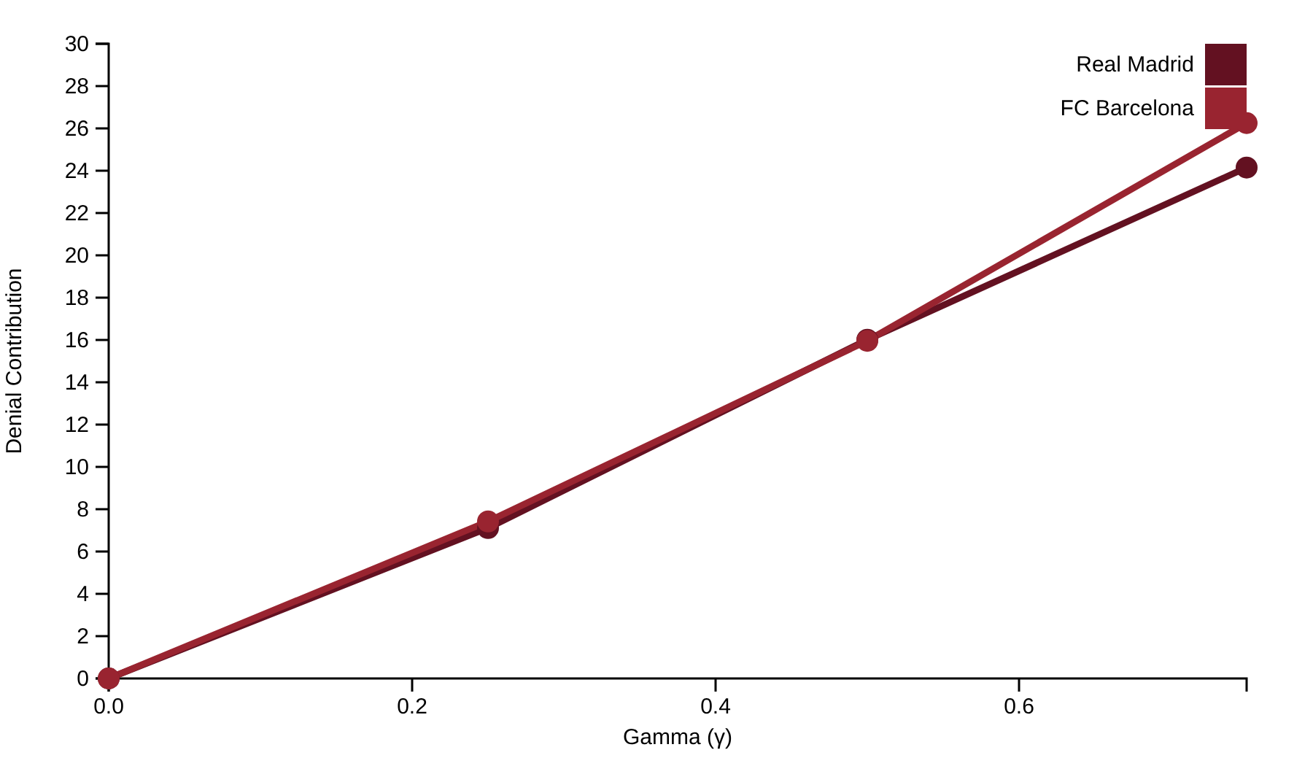

Denial Contributions
Denial Growth
Denial contribution for both teams grows approximately monotonically with increasing gamma parameter.
Key Insight: As γ increases, teams increasingly value transfers that deny opponents critical players.
Takeaway
Denial contribution grows approximately monotonically with γ.

Slide 13

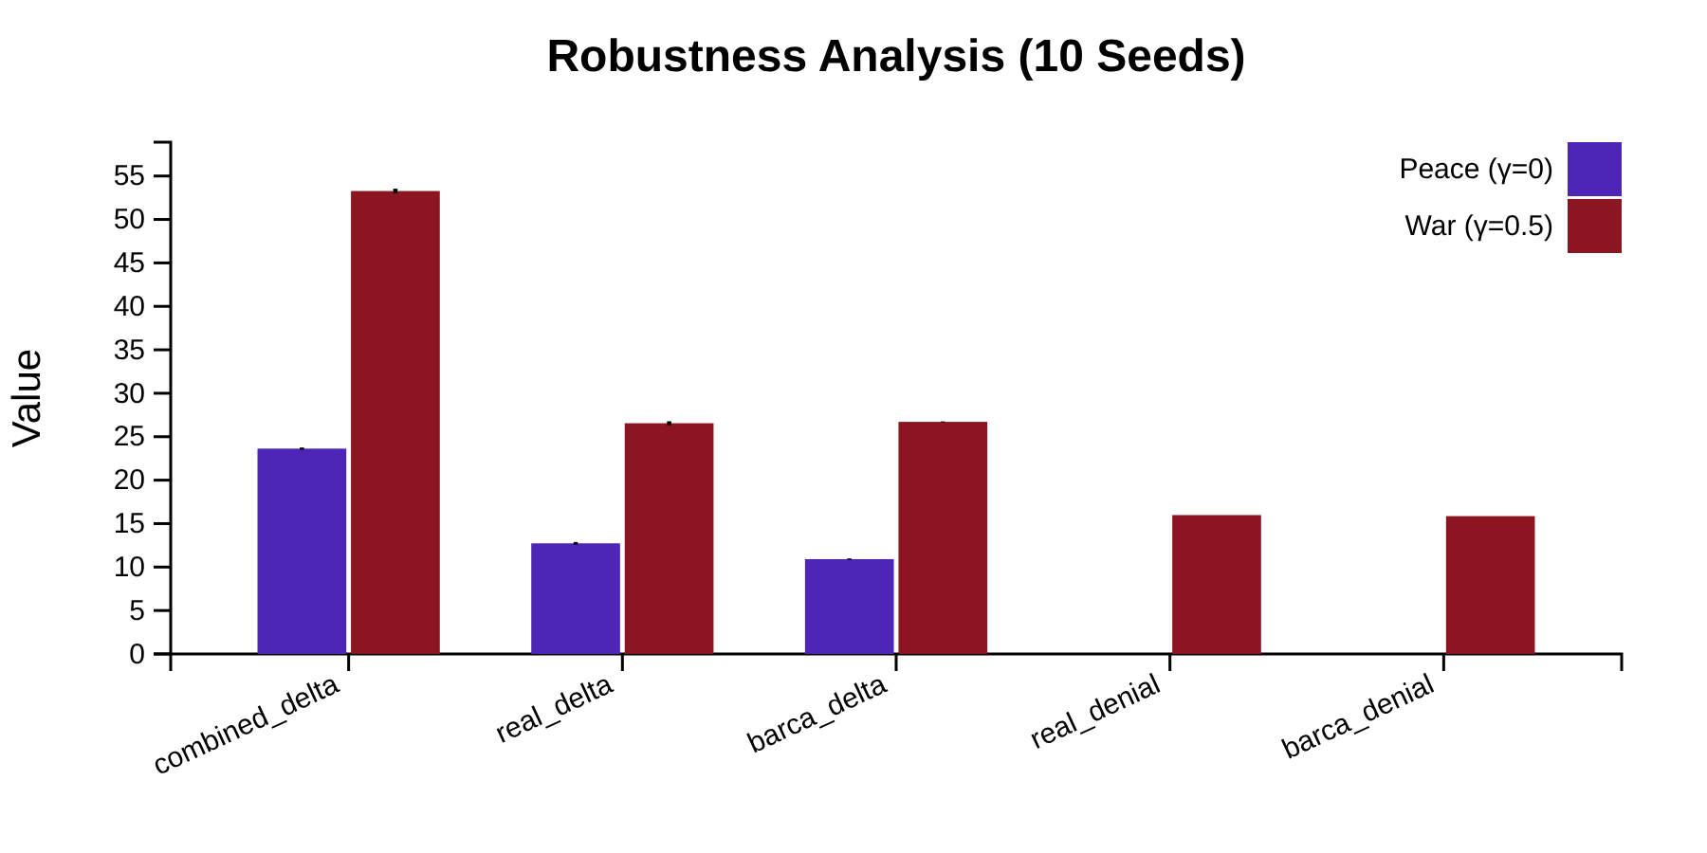


Robustness Analysis
Model Validation
10 replications with different random seeds
Peace (γ=0)
War (γ=0.5)
Low standard deviations indicate stability
Consistent denial contributions
Key Findings
Low variability across random market draws
Denial contribution stable: Real 15.98, Barca 15.86
Conclusions robust across different market conditions
Low standard deviation across seeds indicates stability (robustness) under random market availability.

Slide 14












Conclusions & Validation
Model Validation
Data-driven
Constraint-respecting
Objective framework for transfer decisions
Automatically satisfies all rules
Exclusivity satisfied
Budgets feasible (including sell revenue)
Untouchables not sold
Comprehensive
Strategic
Forced departures enforced
Considers all possible transfers
Incorporates competitive hostility

